Slide 1


DEV
—DREKGON PRODUCTION
URER

Slide 2

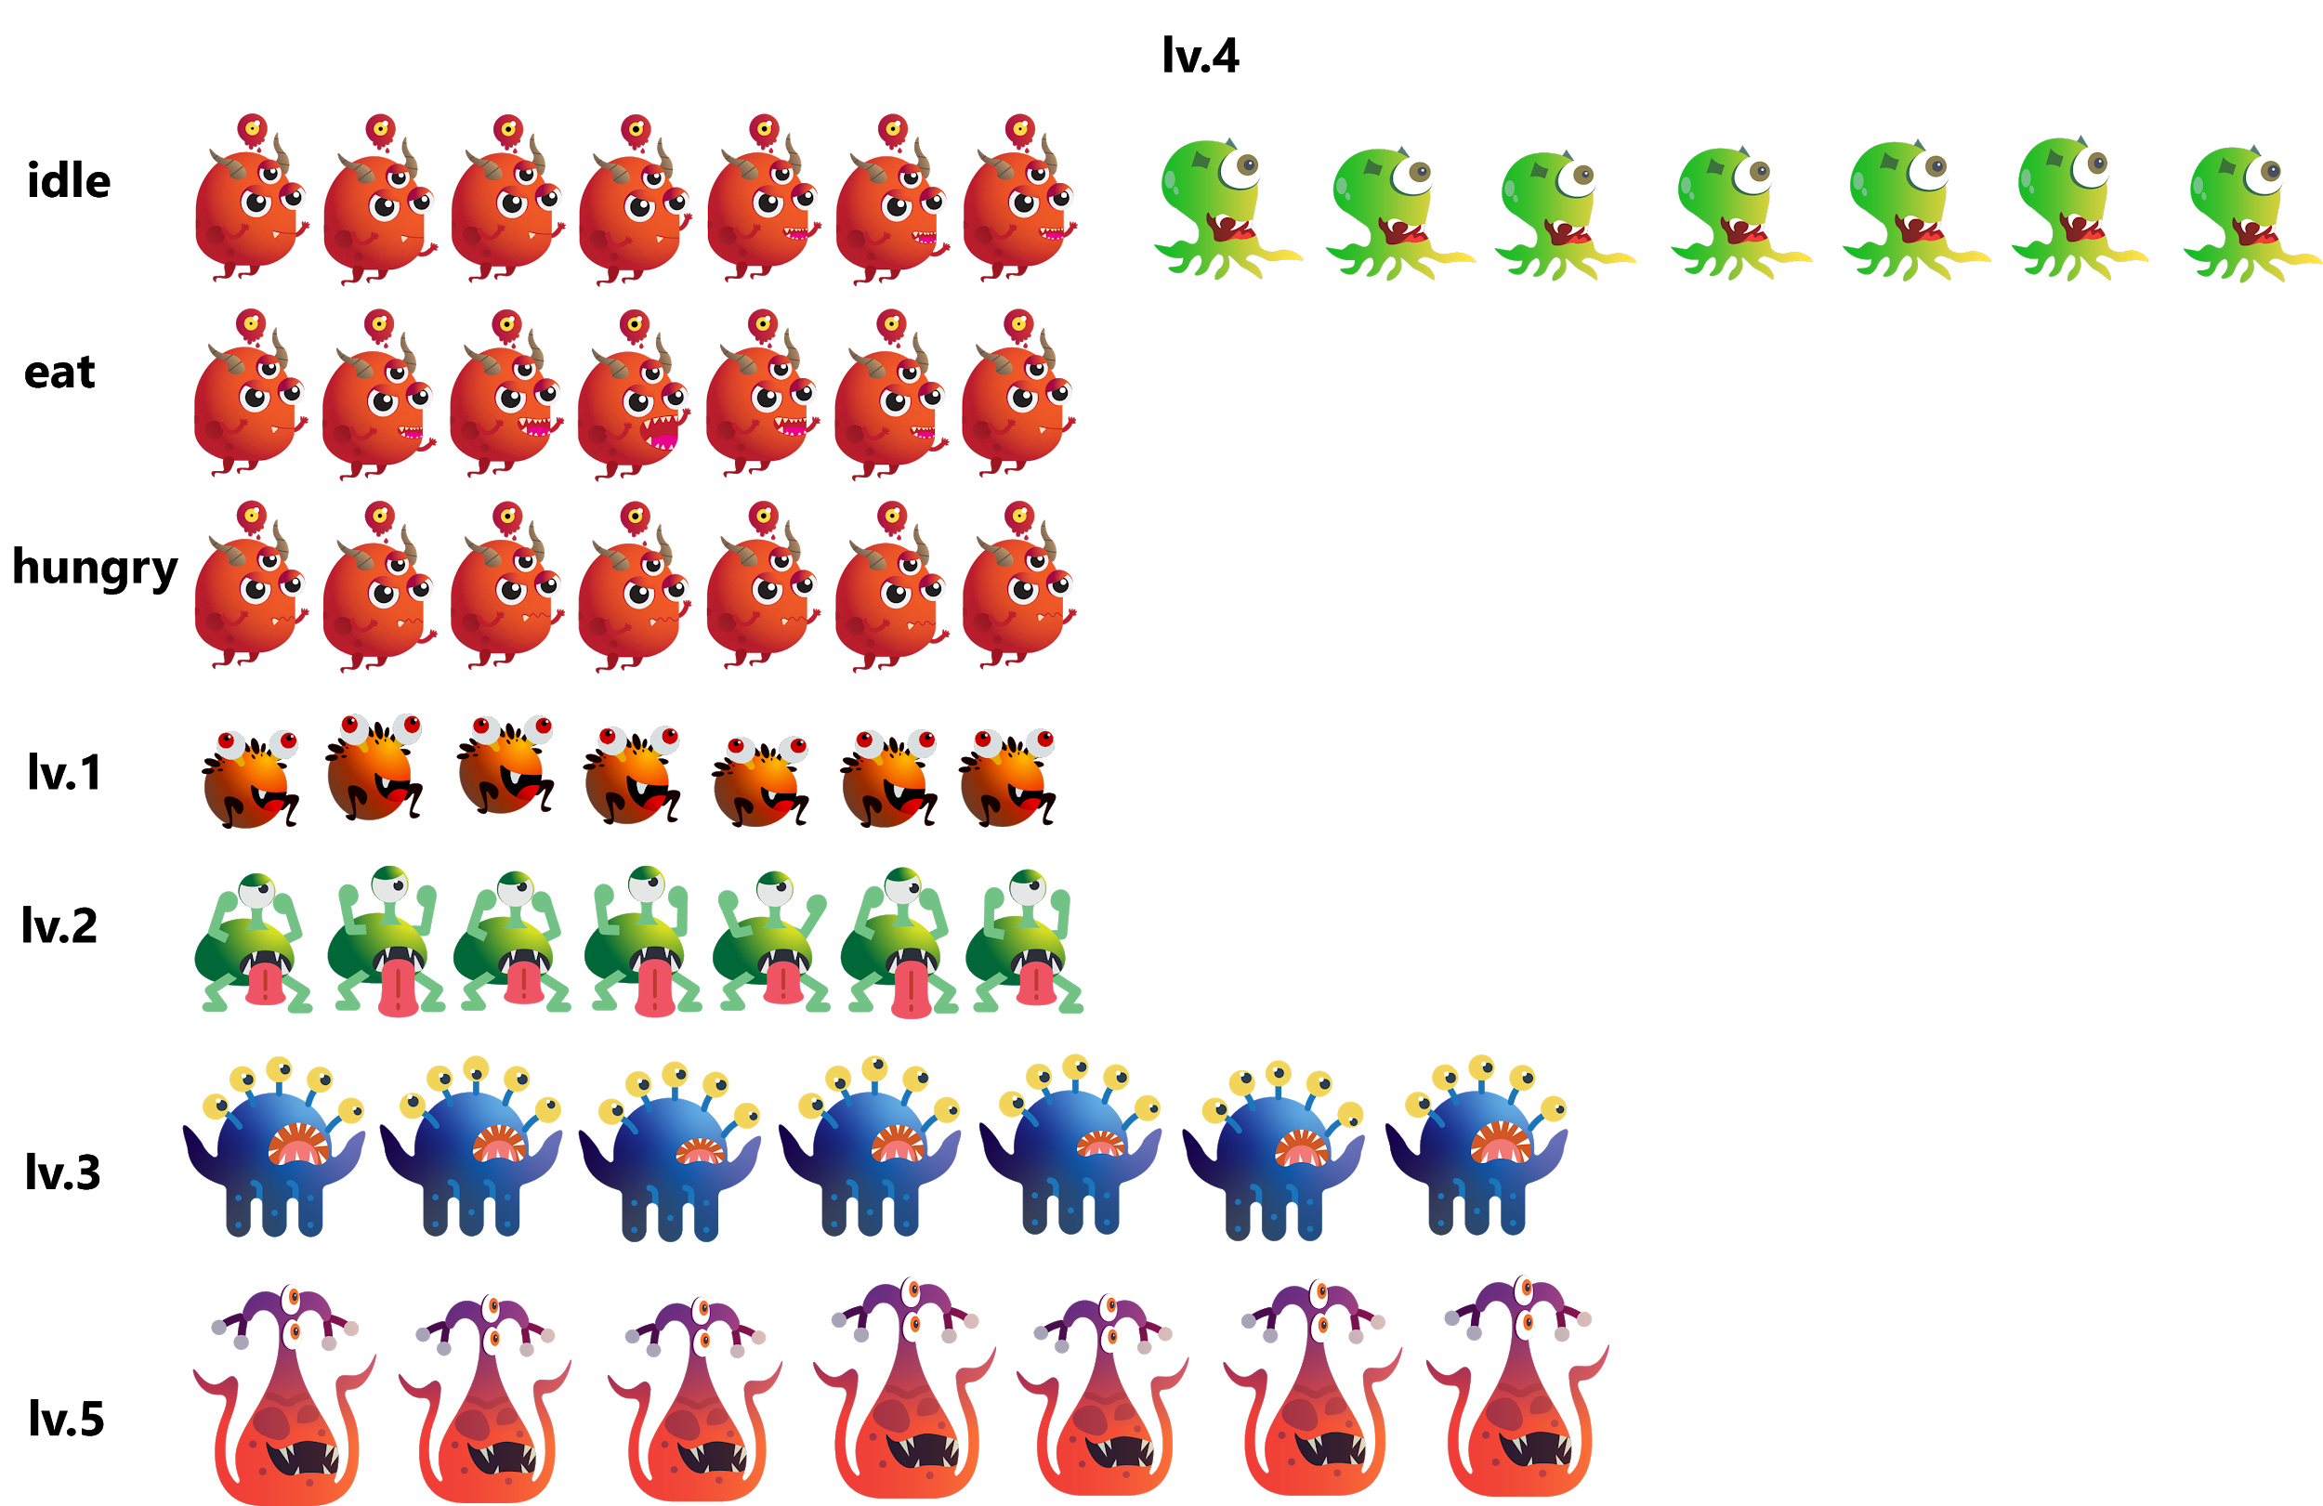
PITCH
Elevator pitch
Game Pillars
Consumer Promise
Tagline
- A Game of Survival: where the Big eats the Smalls & the Small flees the Bigs.
- Survival: Aiming for the Highest Score
- Harder Feeding Frenzy
- Mixed between Cute Art & Scary Environment
- Eat Them All
- The art style might look cartoony, but don’t let it fool you. You must be alert at all times while playing this game.
- Easy to learn, hard to master.
- Use high dexterity but with a low mental calculation.

Slide 3
USP
Horror Hardcore Feeding Frenzy
The longer you survive, the more fun and challenging it gets

Slide 4
“
IN-
TRODUCTION
“
Devourer is in the same genre as Feeding Frenzy. However, its uniqueness lies in its endless gameplay. The player’s ability is measured by the higher score he gets. The key to survive is to eat smaller preys, while running from bigger predators. Try not to get eaten and survive another day.

Slide 5
Winning Conditions
Losing Conditions
- Eat smaller monsters
- Reach New High Score
- Survive as long as possible
- Get eaten by stronger monsters
- Get killed by traps

Slide 6
Product
Key
Points
Genre : Action
Target Audience :
Students Under 18 years old: 21% of total U.S players, 39 minutes average time spent on games daily
Slither.io fans: 68 million downloads, 67 million daily active users on web browser
Dark Comedy Cartoon fans: 15million hits per month
Platform : PC
Game Engine : Unity

Slide 7


REFERENCES
— Feeding Frenzy 2
200k Download
998k Revenue
— Hungry Shark
600k Download
300k Revenue

Slide 8
Competitor
Analysis
Title: Feeding Frenzy
Publisher: PopCap Games
Genre: Action
Platform: Windows, Macintosh, Xbox, Xbox 360
Release date: February 11, 2004
Price: $5–20 (From Xbox Live Arcade service)
User score/Metascore: IGN: 6.6/10 , Eurogamer: 3/10

Slide 9







POSITIONING
Owners
100000-200000 ,$4.99
50000-100000 ,$0.99
20000-50000 ,Free
Devourer
Price
0-20000 ,$4.99
0-20000 ,$7.99
0-20000 ,$4.99
0-20000 ,$0.99
0-20000 ,Free

Slide 10
POSITIONING
Released
Devourer
20/02/2019 ,93%
31/01/2018 ,0%
07/10/2017 ,77%
22/11/2017 ,83%
20/06/2017 ,0%
02/09/2016 ,96%
Old user score
09/12/2016 ,0%
30/08/2006 ,95%

Slide 11
POSITIONING
Skill
Chance
Mental
Calculation
Devourer
Physical
Dexterity

Slide 12
CORE GAME LOOP
Eat the Smalls
Avoid obstacles
Survive

Slide 13

FEATURE LIST
The player earn score points by eating smaller creatures. He will progress to the next level after consuming enough creatures.
Higher level unlocks more advance creatures, which award higher score points.
A variety of buffs with distinctive ability.

Slide 14
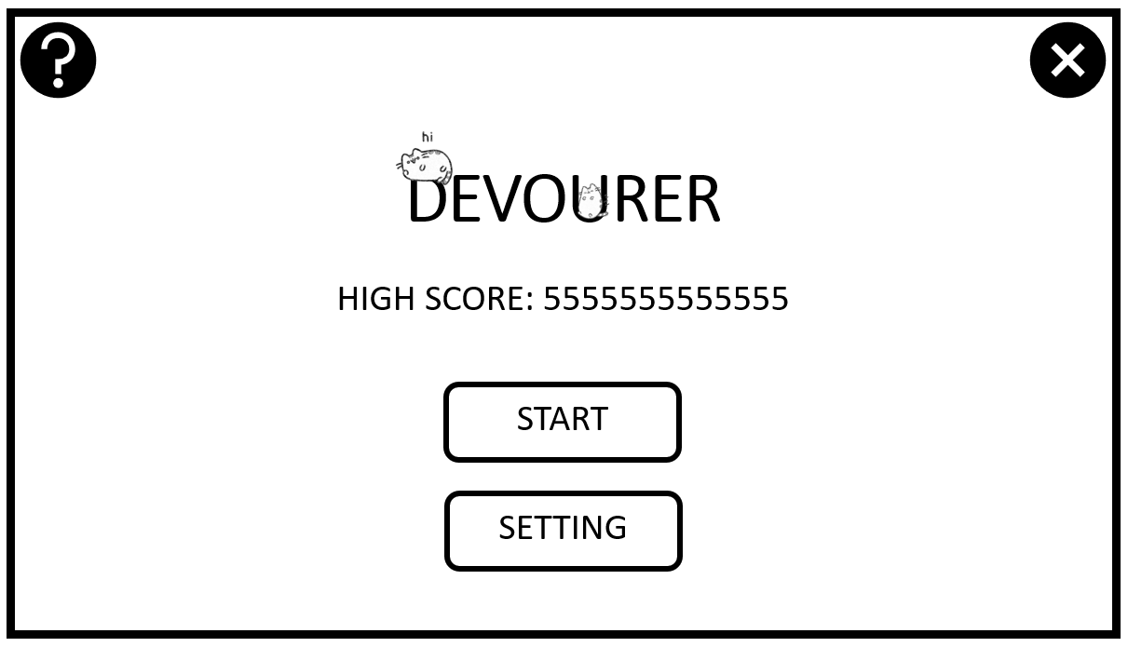
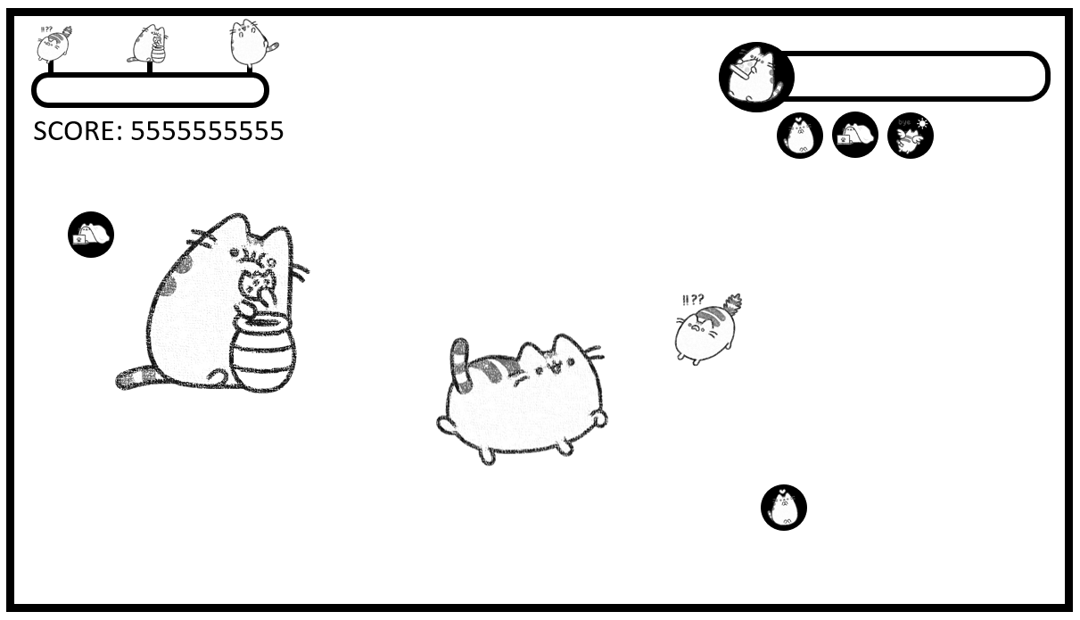

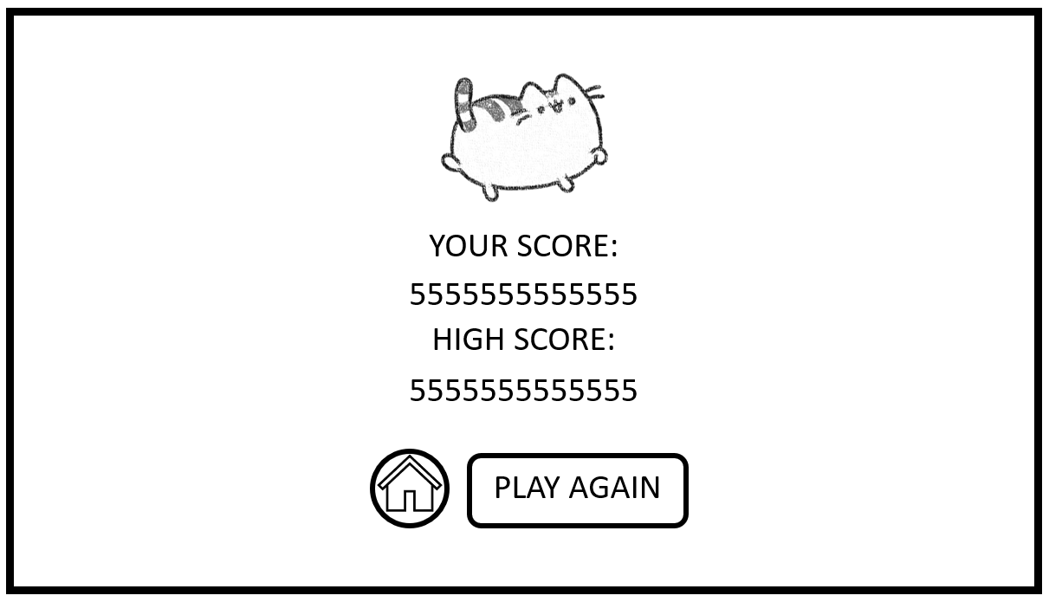
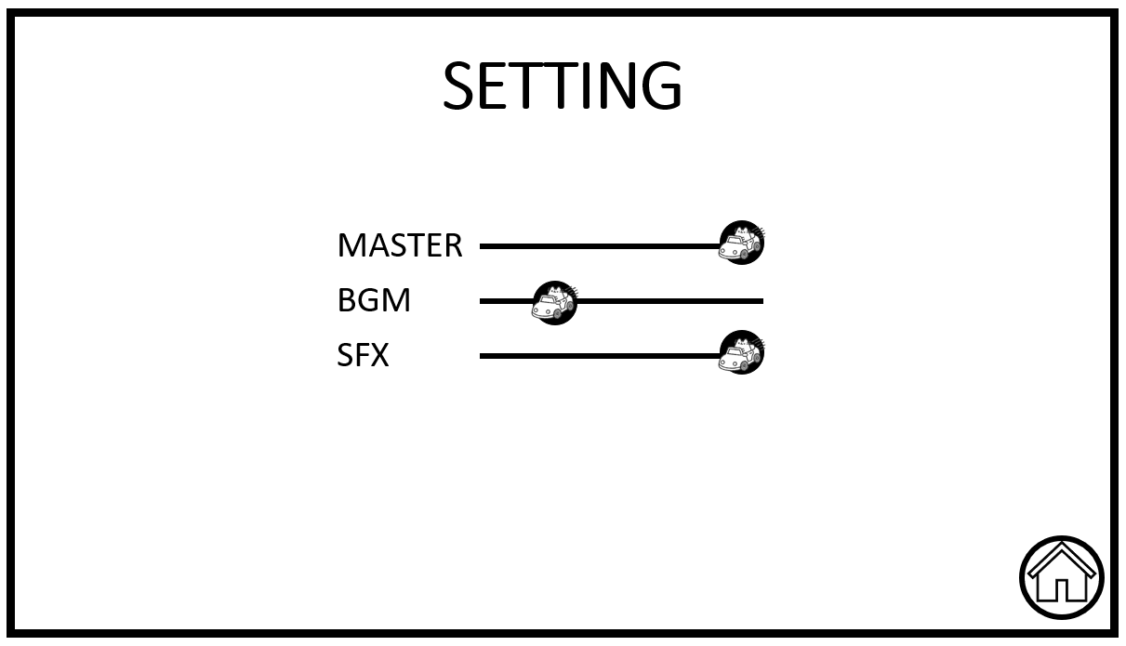
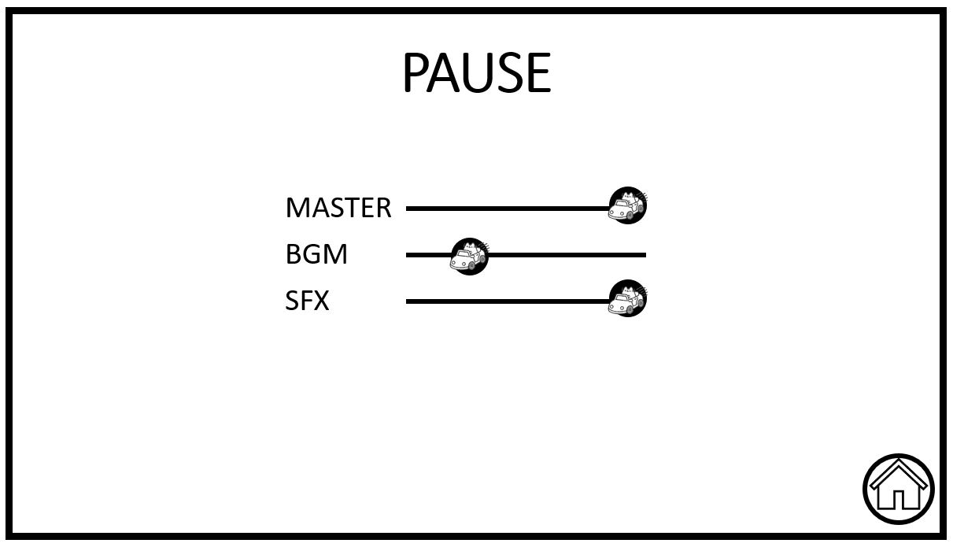
Mock Up

Slide 15
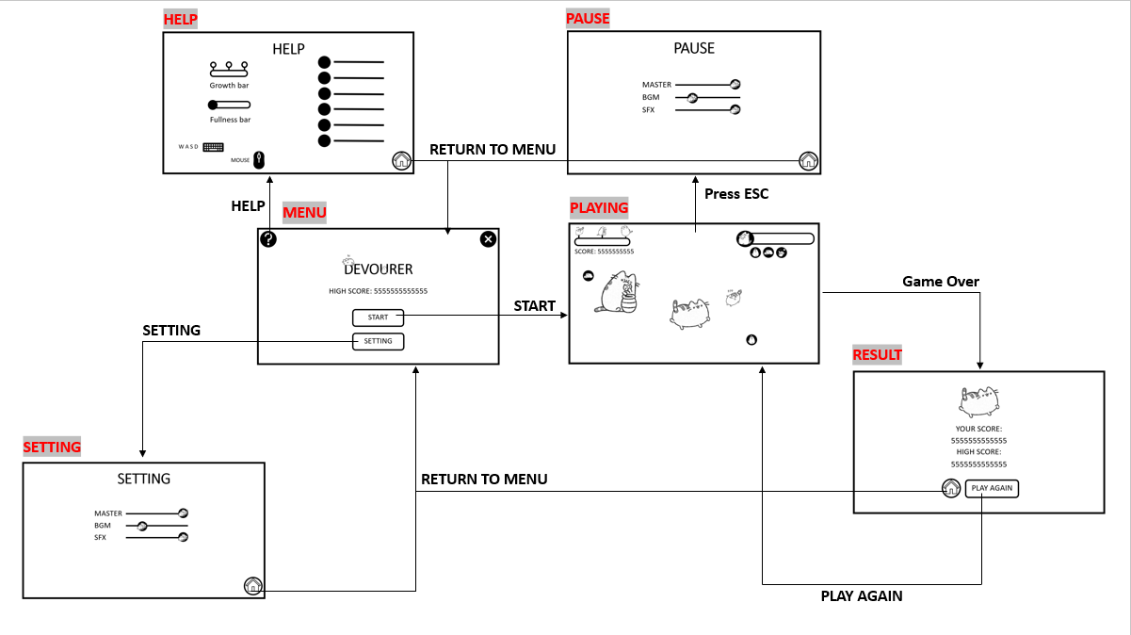
UI Flow

Slide 16
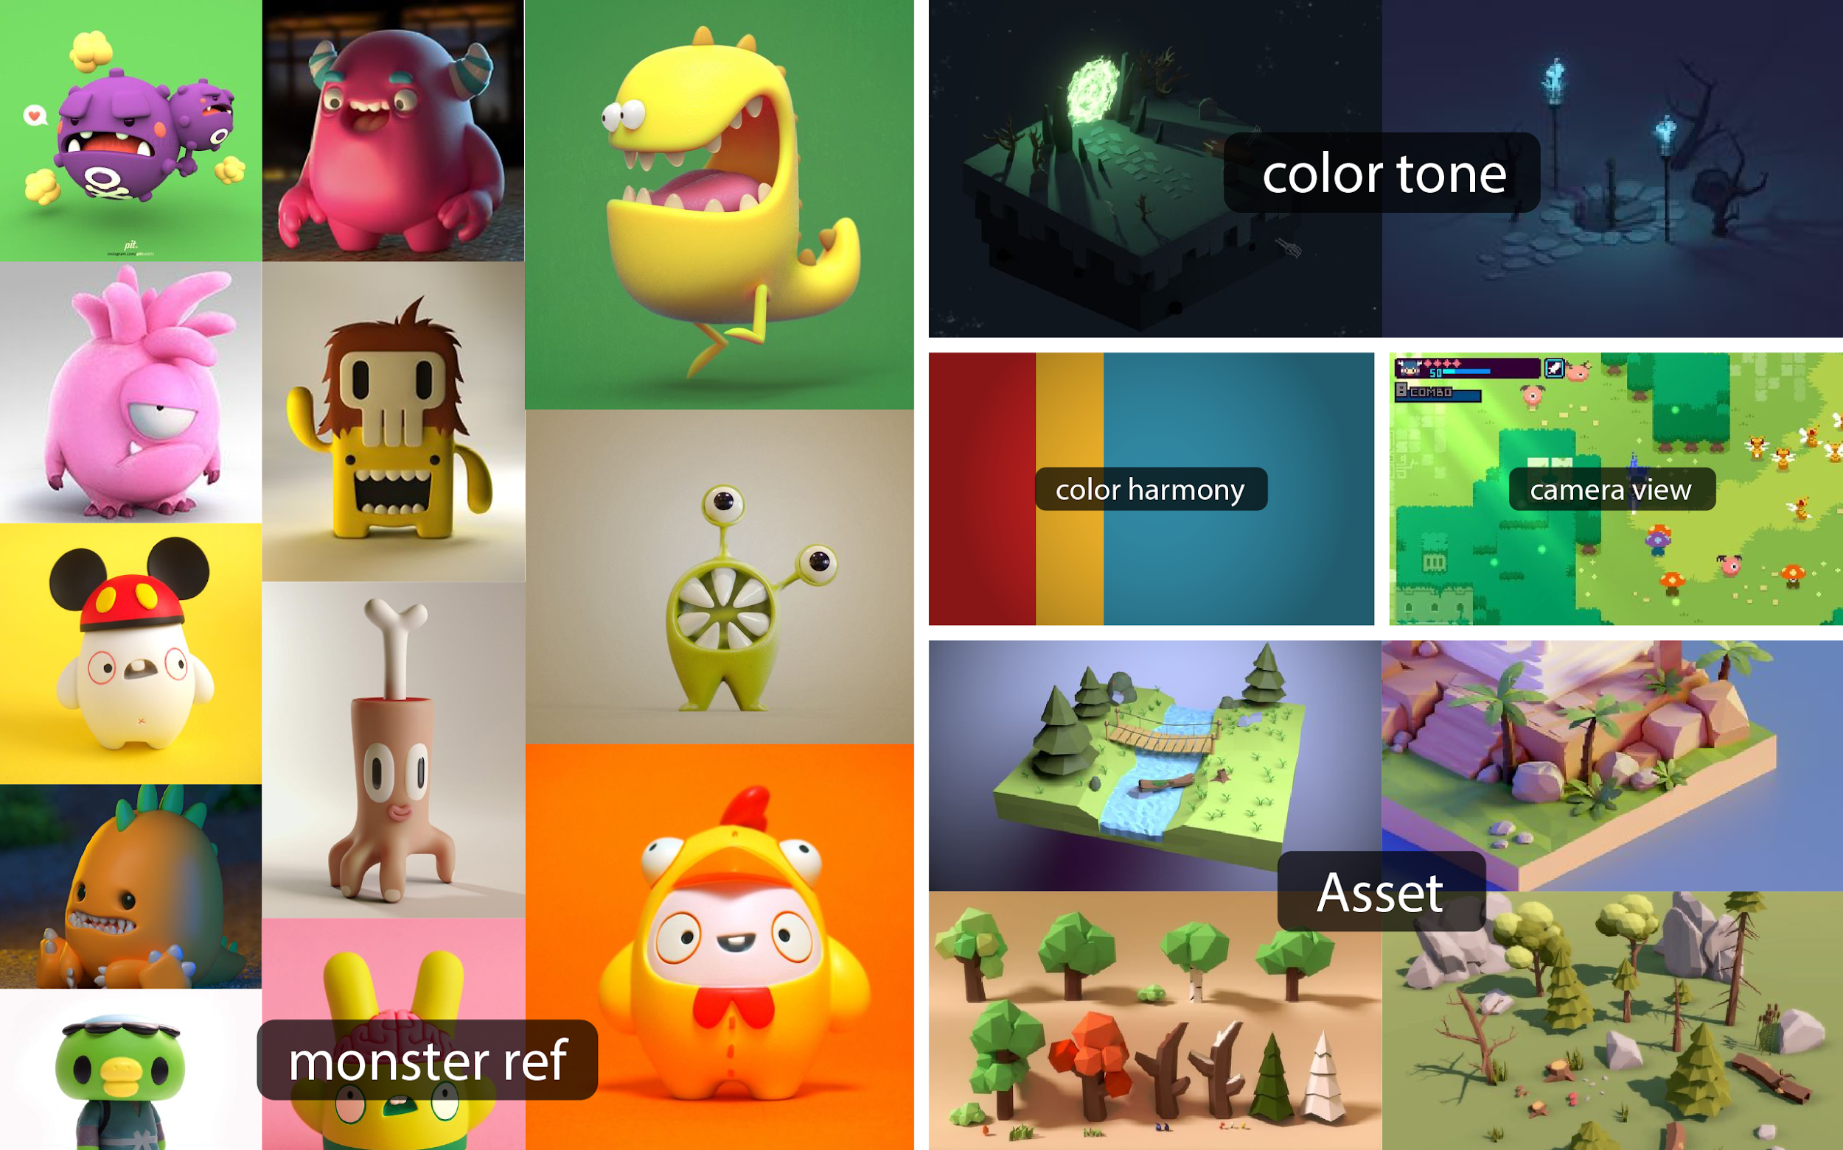
ART DIRECTION

Slide 17
PRICE
Free to play
Become a VIP with only 2$

Slide 18
Campaign Plan
20/9
Teaser Trailer
24/9
Beta test
3/10
Game lunch
11/10 - 5/11
Halloween's Event
17/11
Big Update
11/10 - 5/11
Christmas Events

Slide 19
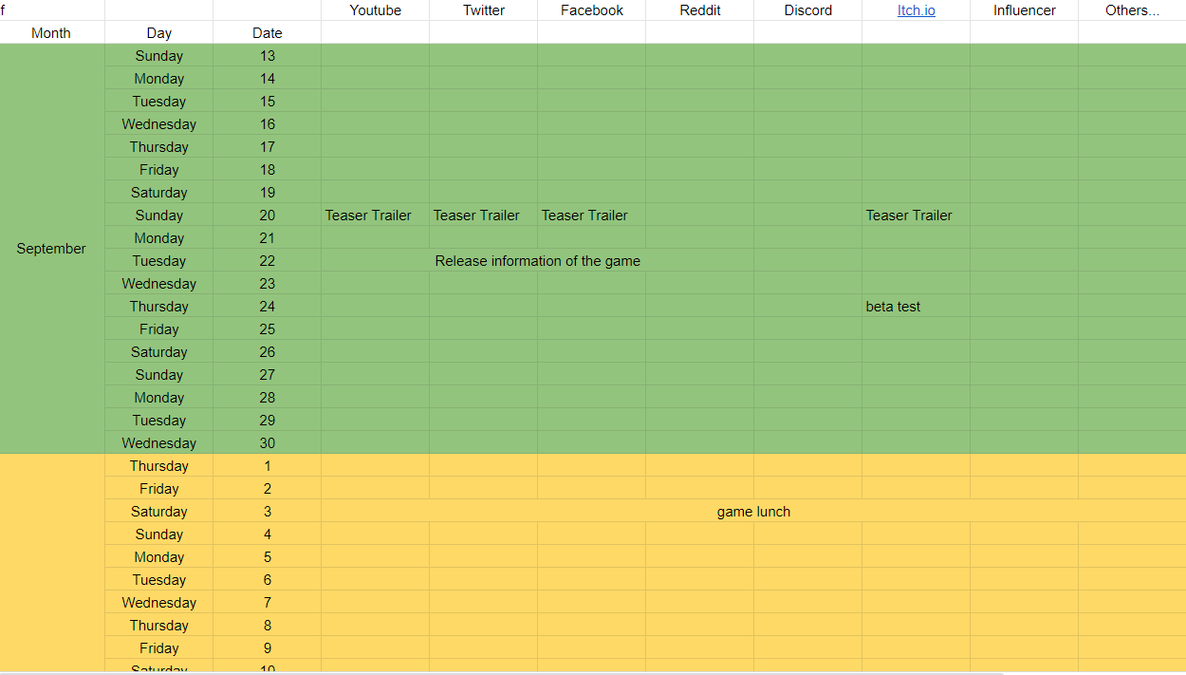
Timeline/Roadmap

Slide 20
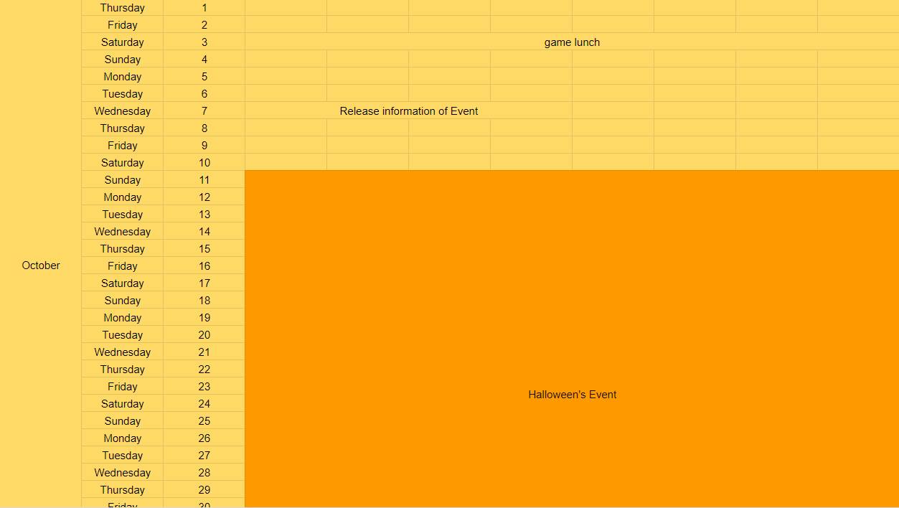
Timeline/Roadmap

Slide 21
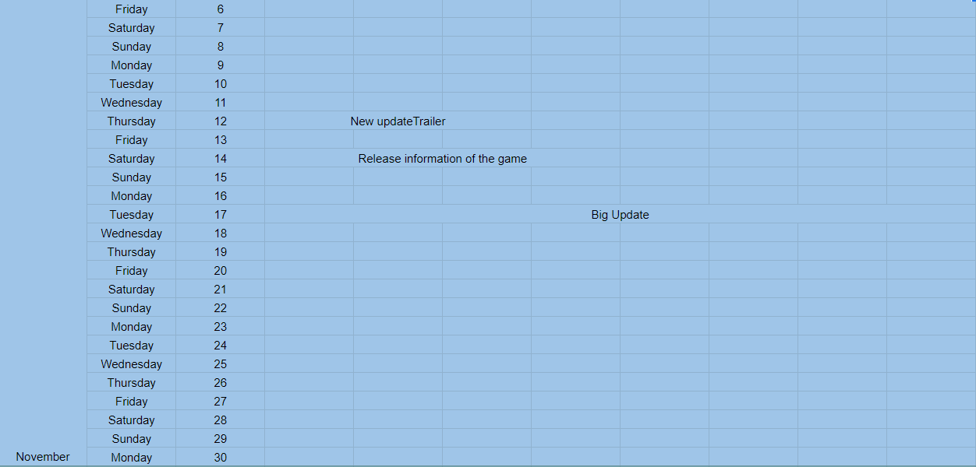
Timeline/Roadmap

Slide 22
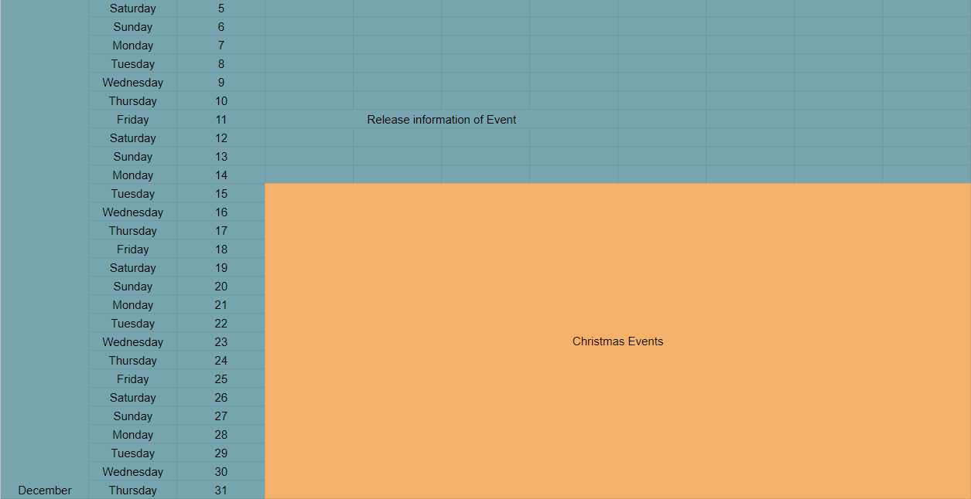
Timeline/Roadmap

Slide 23







Publishing Strategy
Facebook, Youtube, Twitter, Discord, Reddit, Tiktok
Brand message
Channel

Slide 24

Persona
Occupation : Student Education : High school
Address : Hanam Income : 10,000฿ from family
Age : 18 Identity : single
Daily life : Study at 8.00-17.00 Usually playing games around 21.00-23.00
Personality : She isn’t taking life seriously & love mystery stories.
Problem : Our past games are often unconventional. So the solution is to add some features that are not
found in this genre of games.
Feelings :This game gives a feeling of relaxation when playing but have a lot of mystery to discover.
Media and Influential People :
- The media that we use regularly are Facebook, Youtube, Twitter, TikTok
- She likes to read books & play game.
Yeo ju da

Slide 25
Team members
Surittee Nuphong (Project Manager)
Wassapol Pungjap (Lead Programmer) (Co-Founder)
Chitawon Sathapornvanich (Programmer)
Nichanan Sakornoi (Game Designer) (CEO)
Sunisa Chanbang (Art)
Nichapat Kachacheewa (Art)
Suphakit Nachom (Art)
Supaphol Kottom (Marketing)

Slide 26
Thank you
Contact
Surittee111953@gmail.com
Project Manager (CEO)

